Slide 1

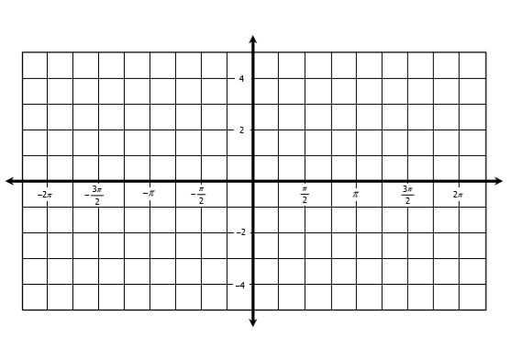
Identify the amplitude (if possible) and period of each function, then graph.
1. Amp: ________ Per: _________
2. Amp: ________ Per: _________
3. Amp: ________ Per: _________
4. Amp: ________ Per: _________
Identify the amplitude (if possible), period, translations, and midline. Then graph.
5.
Amplitude:
Period:
Phase Shift:
Vertical Shift:
Midline:

Slide 2

6.
Amplitude:
Period:
Phase Shift:
Vertical Shift:
Midline:
7. Find if and .
A. C. B. D.
8. Find if and .
A. C. B. D.
9. Find the exact value of .
A. C. B. D.
10. Find the exact value of .
A. C. B. D.

Slide 3

11. Find if A and B are positive acute angles with and .
A. C. B. D.
12. Find if A and B are in Quadrant II with and .
A. C. B. D.
13. Find the exact value of if and .
A. C. B. D.
14. Find the exact value of if and .
A. C. B. D.
15. Find the exact value of if and .
A. C. B. D.

Slide 4

16. Find the exact value of if and .
A. C. B. D.
17. Find the exact value of if and .
A. C. B. D.
Simplify each expression.
18.
19.
A. B. C. D.
A. B. C. D.
20.
21.
A. B. C. D.
A. B. C. D.

Slide 5


22. Which expressions are equivalent to ? Check all that apply.
Prove each identity.
23.
24.
Solve each equation for the interval . Give all solutions in degrees.
25.
26.

Slide 6

27.
28.
29.
30.
Directions: Solve each equation for the given interval. Give all solutions in radians.
31.
32.

